Slide 1

Sync+ 2.0
P702–Desay_EESE&CVPP parts
China EESE&CVPP
Updated on 2022-1-31
Desired Outcome
Awareness
Decision
Escalation Help
Think
Point of view
Plan to Implement
Implement

Slide 2
{R07.1 PRO HF2} Software overall status {yellow}
Software key info
  Refer SWAD for the details:
    MCU version:20220114_382_PRO
    SoC version:20220127_0627_A2F12_R07.1.PRO.HF2_Debug
  Verification scope and method:
    {Full verification} executed with pass rate 98.34%, 3P1 and 67P2 issues found and not fixed. Refer test report for detail.
Main changes compared with previous version, refer RN for the details, highlights listed below:
    Non-compliance issue list, refer attached file for detail
    Open P1 issue list with risk evaluation – refer slide 3
    Open P2 issue list with risk evaluation – refer slide 4
    Open AIMS issue list with risk evaluation – refer slide 5
    Performance Test Result – refer slide 6
    OTA Test Result - refer slide 7
Notes:
Add P1 weekly burn down chart

Slide 3
{R07.1 PRO HF2} Open P1 issue list with risk evaluation
AIMS # | Key | Summary /recurrence rate, recover method, impact | Status | Supplier | Creation date | Fix Version/ with date | Root cause | Risk evaluation for {R07.1 PRO HF2}
3860051 | APIMCIS-23668 | 【P702】【setting】【必现】点击找到泊车位开关无响应 Recurrence rate：100% Recover method：NA Impact：直观显示问题，用户可感知，功能切换正常，引起抱怨可能性较小 | test | Desay | 2021-12-10 11:44 | R08 | 泊车位开关已经disable，上级菜单提示音会在R08版本修复 | L
 | APIMCIS-26195 | 【必现】【P702】挂倒挡， 泊车雷达按钮无法关闭 Recurrence rate：100% Recover method：na Impact：功能问题 | Awaiting implementation | Desay,Ford | 2022-1-12 10:31 |  | 对手件问题 | L
 | APIMCIS-19899 | 进口车项目P702和S650的车机系统DuerOS里道路救援说明内容里需要把“长安”两个字删掉 Recurrence rate：100% Recover method：na Impact：HMI显示问题 | test | Desay | 2021-10-19 9:46 | R08 | 文本显示问题，会在R08版本修复
Notes:
Add P1 weekly burn down chart

Slide 4

{R07.1 PRO HF2} Open P2 issue list with risk evaluation
Gating | 计数项:Status
Awaiting implementation | 23
In Progress | 4
Reopened | 4
Test | 32
To Do | 4
总计 | 67
Notes:
Add P1 weekly burn down chart

Slide 5

{R07.1 PRO HF2} Open AIMS issue list with risk evaluation
AIMS Issues | 计数项:Status
Approval | 2
Awaiting implementation | 1
Done | 43
Monitor | 2
Rejected | 16
Test | 4
总计 | 68
Notes:
Add P1 weekly burn down chart

Slide 6
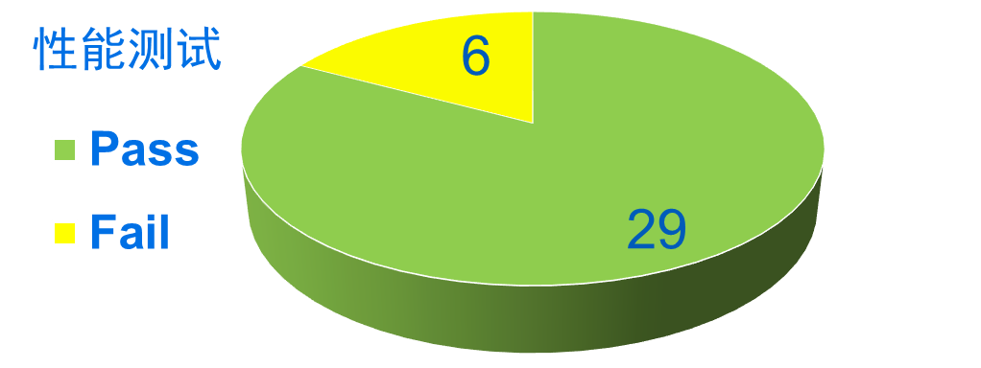
{R07.1 PRO HF2} 性能测试状态
Test item | Spec | R07 | R07.1 | Remark
The time difference from Power Off state to navigation system available for user interaction 打开导航应用 | 28 | 31.73 | 29.60
The time difference from Power Off state to PTT ready语音硬按键 | 31 | 31.96s | 34.75
The time difference from Power Off state to voice recognition ready语音唤醒可用 | 31 | 34.8s | 32.26
The time difference from Power Off state to the request for the last Audio source (BT Media) 睡眠后从点火到播放蓝牙音乐声音 | 34 | 39.43 | 40.12
SDM冷启动时间（可以更改SDM设置） | 23 | 27.79 | 25.28
BT连接时间，从确认配对到播放BT音乐或者打电话的时间 | 6 | 7.34 | 9.14
Notes:
Add P1 weekly burn down chart

Slide 7
{R07.1 PRO HF2} OTA测试状态
Function Name | Total Test Case | Passed Test Case | Failed Test Case | Percentage of Test Completion: | Test Cases Pass Percentage:
TC_SOC_OTA | 83 | 76 | 3 | 95.18% | 96.20%
TC_MCU_OTA | 69 | 68 | 0 | 98.55% | 100.00%
TC_MCU_USB | 63 | 60 | 2 | 98.41% | 96.77%
TC_SOC_USB | 63 | 60 | 2 | 98.41% | 96.77%
Total | 278 | 264 | 7 | 97.48% | 97.42%
Test Summary Description
主要问题： 1.系统更新中界面左上角缺少退出按键 2.屏幕上划关闭系统更新消息后，下划查看消息已经被清除，
Notes:
Add P1 weekly burn down chart

